Slide 1


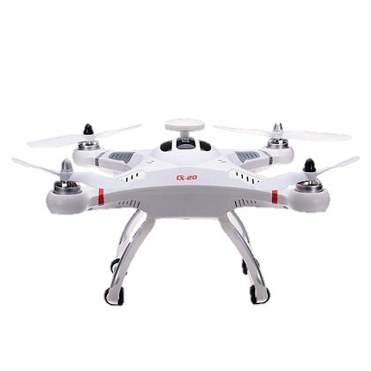
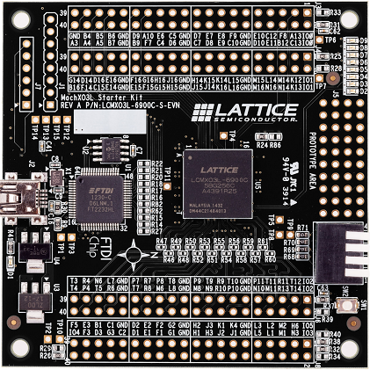
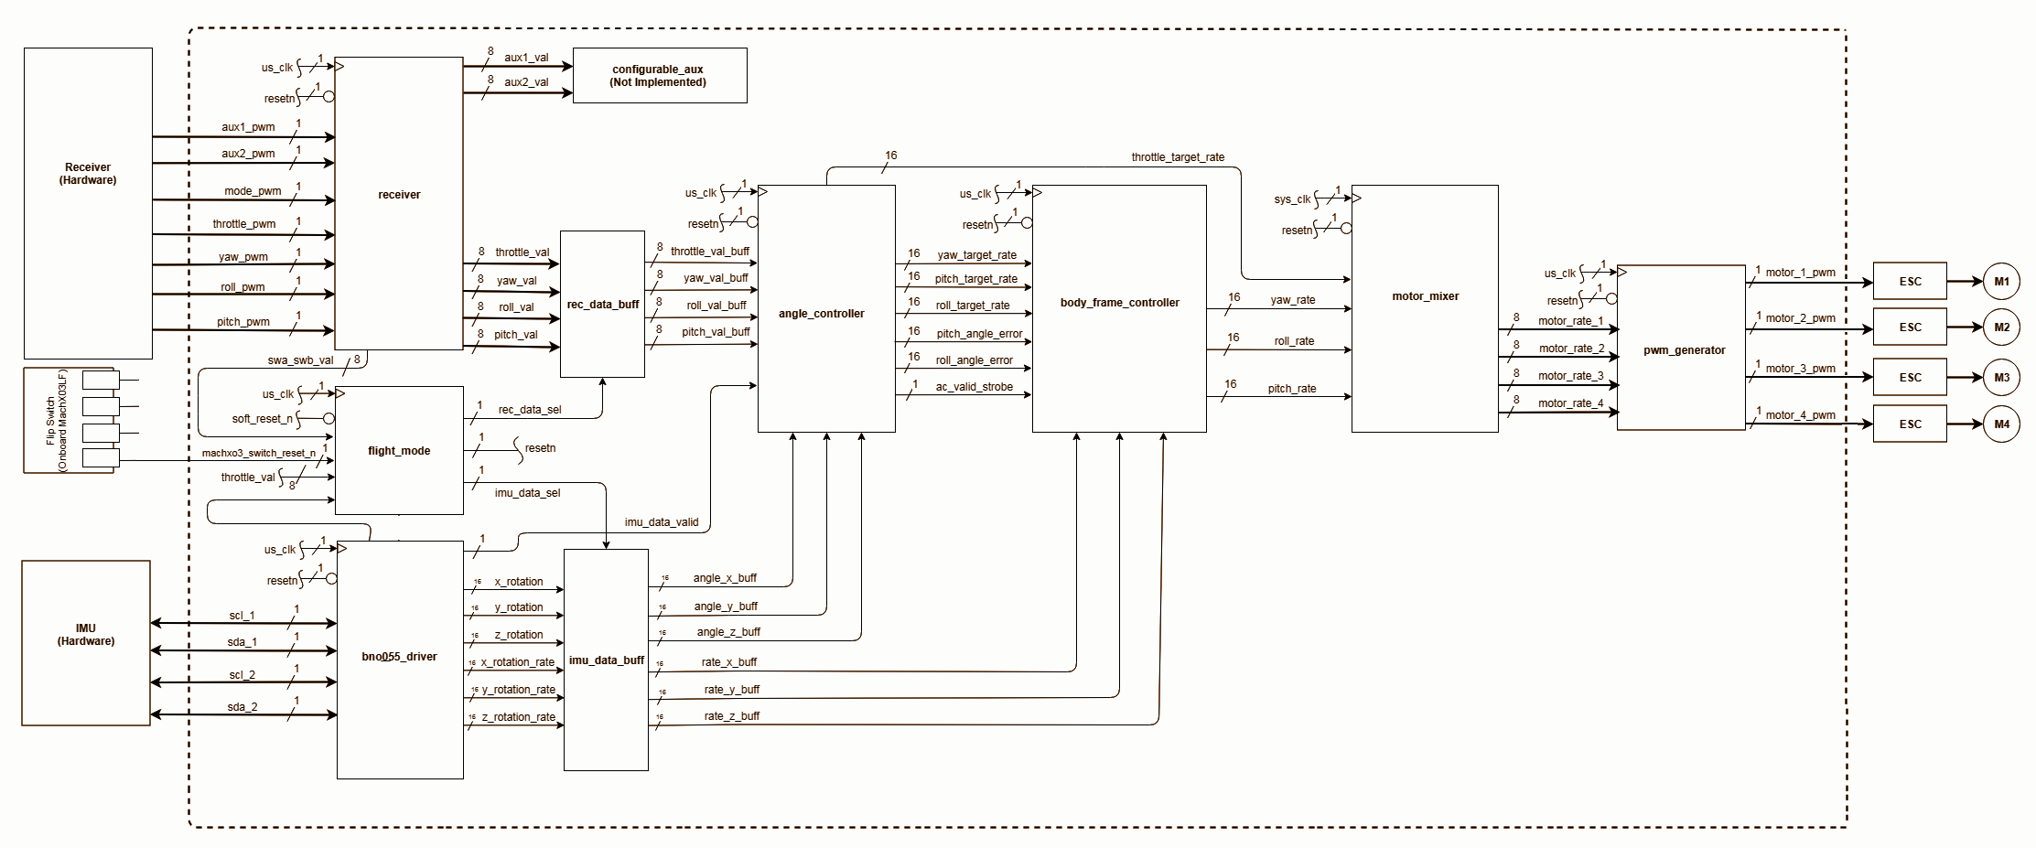
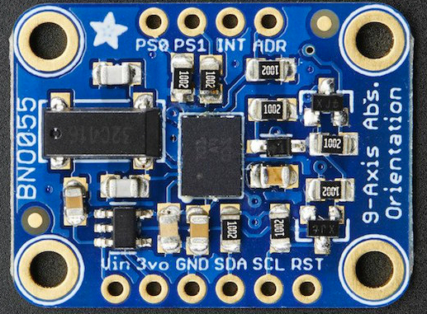
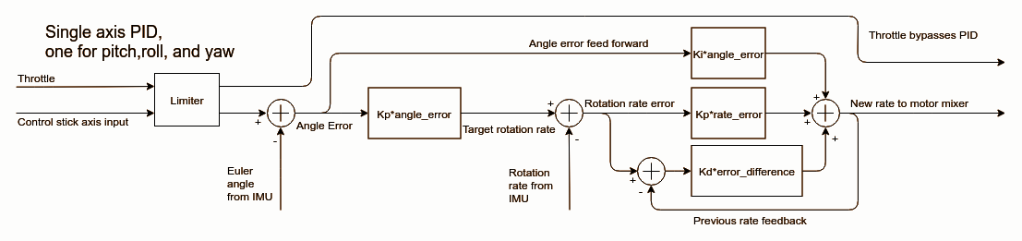
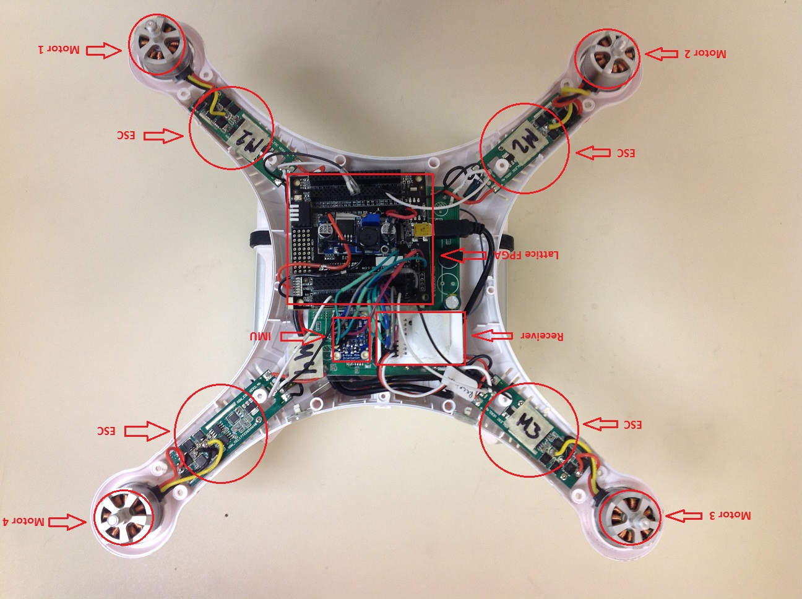
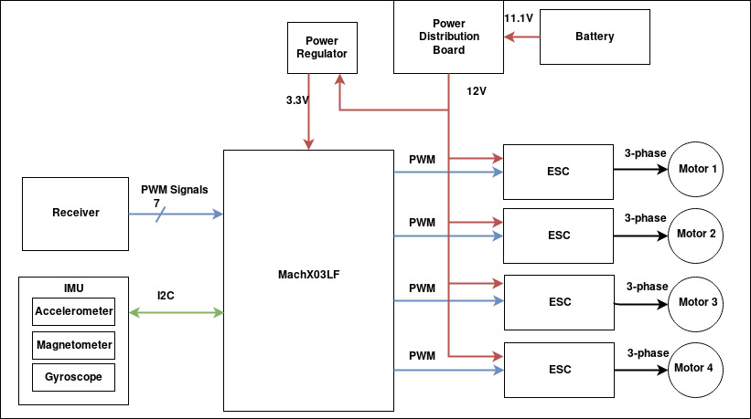
FPGA Quadcopter Flight Controller
Brett Creeley, Daniel Christiansen, Ethan Grinnell, Kirk Hooper, and Zachary Clark-Williams
Maseeh College of Engineering and Computer Science, Portland State University, Portland, Oregon
Software Block Diagram
Cheerson CX-20 Quadcopter
(Provided by Lattice Semiconductor)
Bosch 9 Axis
Inertial Measurement Unit
(Team Purchased)
Lattice MachX03
(Provided by Lattice Semiconductor)
Project Description
This project’s goal was to create a stable flight control system for a Cheerson CX-20 drone platform using a Lattice Semiconductor FPGA development board. Consumer drones such as the CX-20 typically require multiple microcontrollers for motor control, system monitoring, RF communication, etc. Using multiple SoCs increases the cost and power requirements for consumer drones, making them impractical for use as a flight controller.
The advantage of using a single FPGA for flight control and sensor functions is that they have a higher I/O count and can process multiple independent operations in parallel. This negates the need for multiple SoCs, reducing the overall bill of materials cost and power requirements of the drone.
The requirement for this team was to utilize at least one Lattice Semiconductor FPGA device as the central computational engine and integrate at least one external sensor to achieve stable flight.
Original Material Created by our Team
Design Methodology
Task modularity
Agile software development with testing during every stage
Unit test - Verilog module test benches
Integration test - Verilog module test benches and physical testing using oscilloscope
System level test - Black box testing using top level inputs and outputs
Hardware validation
Use of collaboration and communication tools
Slack - Nearly 10K messages
GitHub - Almost 300 commits
Google Drive
Weekly Meetings
Key Learning Points
Complex PID math is difficult to implement in Verilog and would be simplified with the use of a Lattice IP soft-core processor
Accuracy of fixed point arithmetic depends on bit width
Not being explicit with signed variables creates unexpected behavior in Verilog
Future Work
Convert Angular Control to Quaternions
Expand Granularity to 32 bit
Integrate GPS for Auto-Flight
Camera Module
Utilize Soft-CPU Core
PID Control System Diagram
Hardware Block Diagram
Original Material Created by our Team
Future Design Work
Increase data granularity to 32 bits
Convert from euler angles to utilizing quaternions
Use one-shot control protocol for increased motor precision
Integrate camera, GPS, and waypoint based flight control
Acknowledgements
Lattice Semiconductor
Doug Hall
Thanh Truong
CX-20 Internals
(IMU hardware, Lattice FPGA development board and all wiring between these components added by our team. The motors and electronic speed controllers (ESCs) were already part of the Cheerson CX-20)
Original Material Created by our Team

